Slide 1
Microbes & Hexagon
Software Carpentry Final Project
Steven Shi & Justin Lanan

Slide 2
Inspiration and Background
First watch some microbes
https://www.youtube.com/watch?v=4XlzCe5gDu0
Check out 1:40 and 5:50
Then talk about Hexagons
https://www.youtube.com/watch?v=4XlzCe5gDu0
Geometry breakdown
Axial Coordinates
Rotation algorithm
Pixel Mapping

Slide 3







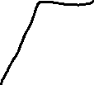
1. Offset from pixel origin 2. Draw imaginary trapezoids 3. Round pixels in/out of the trapezoids
(hx,hy) is defined by its centerpoint.
Trapezoid Slope follows
30/60/90 Trigonometry
(hx,hy) to (px,py)
conversion follows a 30/60/90 Trig algorithm

Slide 4
Index Neighbors Systematically
i = 1
hx
hy-1
i = 0
hx-1
hy
i = 2
hx+1
hy-1
hx
hy
i = 5
hx-1
hy+1
i = 3
hx+1
hy
i = 4
hx
hy+1

Slide 5
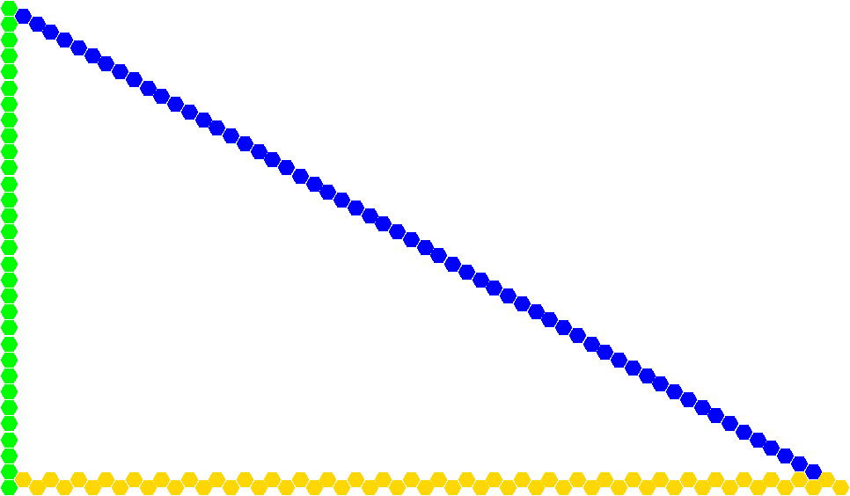
Establish the board (honeycomb) as a Class object. Save the image.

Slide 6
Organisms are glorified Stacks
Each is a separate Class object
Many internal helper functions
Lots of Neighbor Checking
Random 1-step motion over time steps
Turn-by-turn with set order.
Motion utilizes random selections from valid list of moves.
Just simple motions, no hunting/chasing interactions.

Slide 7
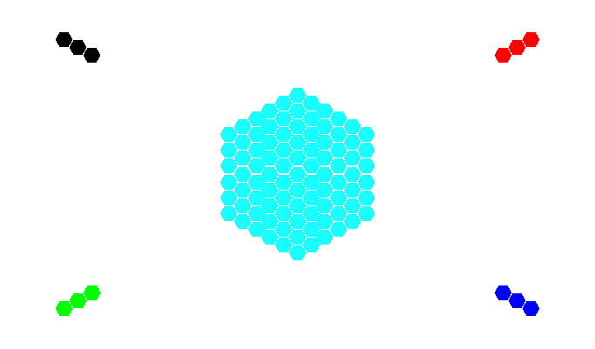
Initialize the Organisms to the Board
1 Amoeba defined by its radius around a center point
Constructed via a “Ring-Making” algorithm
Has a Perimeter sub-Stack
4 little Ciliates
Have a Head, Middle, and Tail

Slide 8
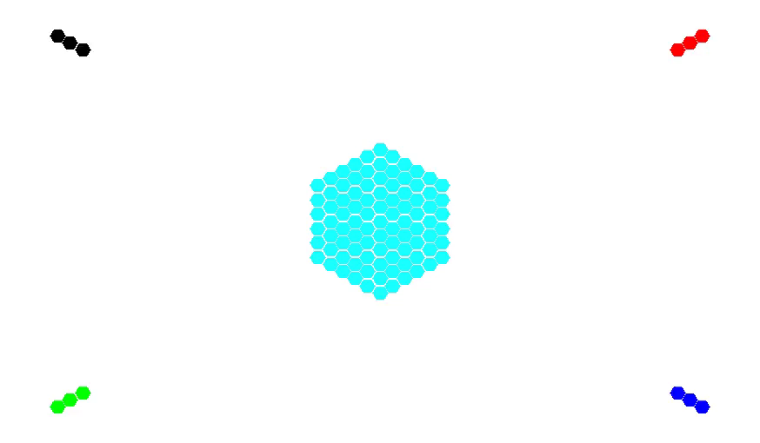
Run Simulation and Make a Movie from all the Images.

Slide 9
Questions?

